Slide 1
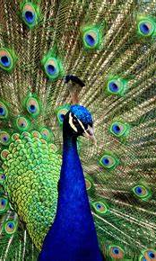
P
Perseverance

Slide 2
E
Equality

Slide 3
A
Aspiration

Slide 4
C
Courage

Slide 5
O
Opportunity

Slide 6
C
Compassion

Slide 7
K
Knowledge

