Slide 1
Aspris Queenswood School
Our Vision

Slide 2
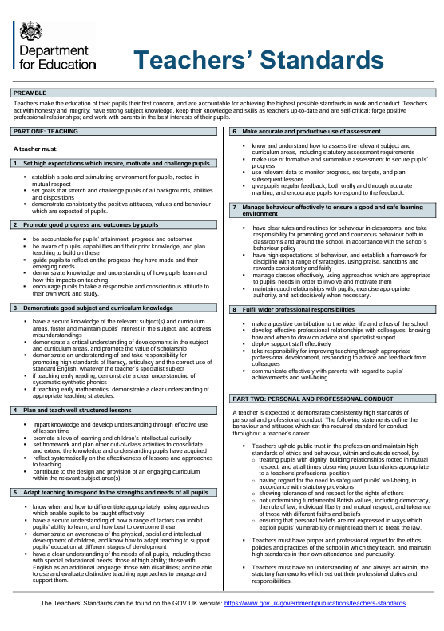
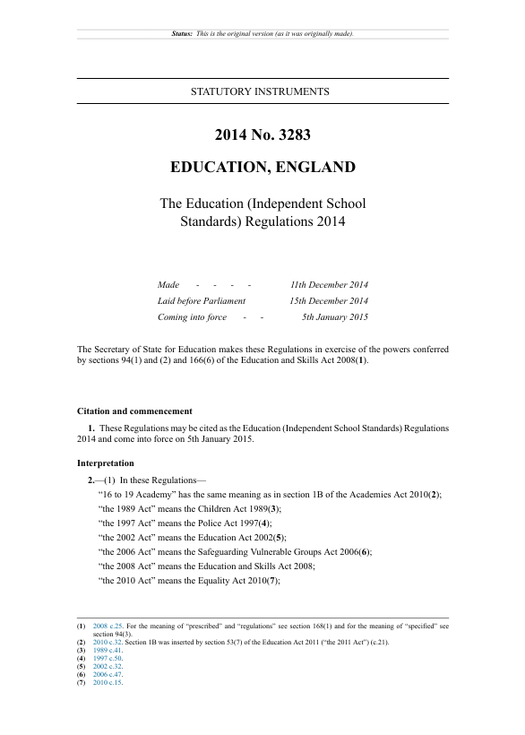
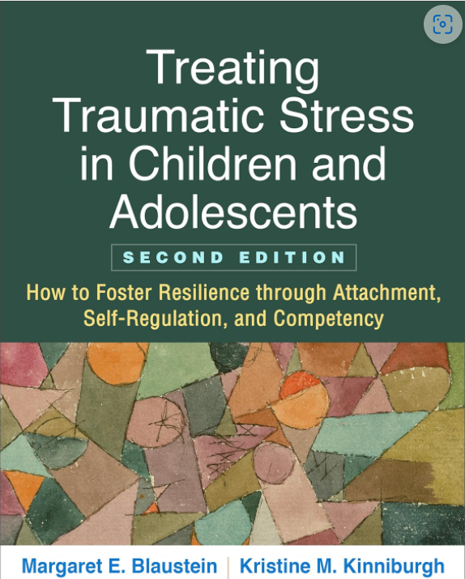
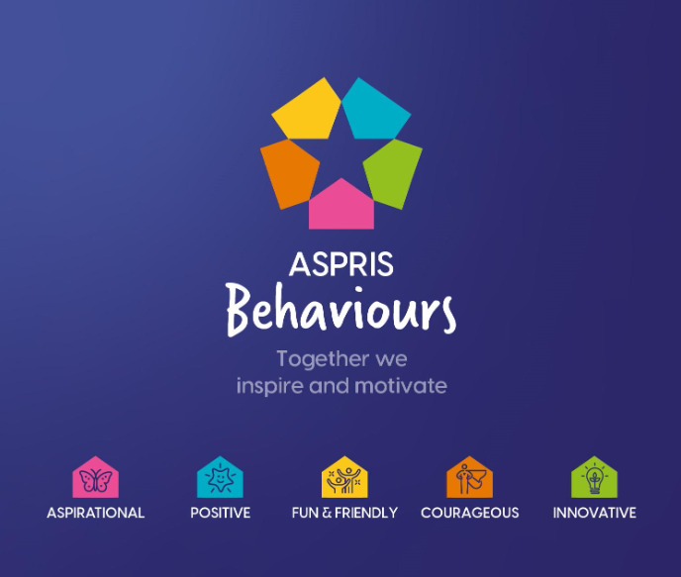
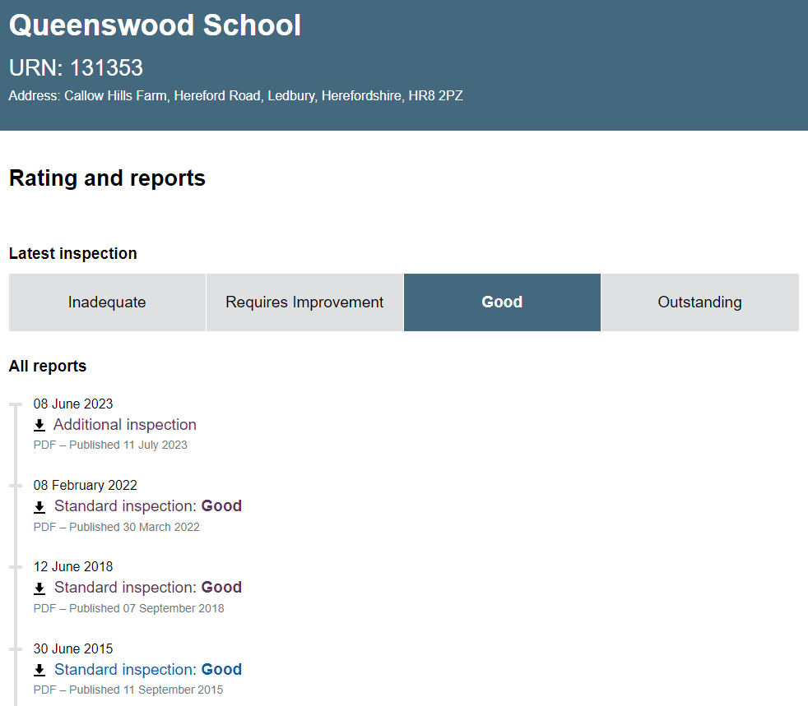
Where does it all begin?
Relationships
Notes:
Fundamental to what we do is to develop, positive, meaningful relationships with the pupils.
TASK – in small groups, can you note down/describe what you feel can be considered as a positive/healthy relationship?
EXTENSION – what should it look like at Queenswood School between staff member and our pupils?
Why?
Teachers Standards
Independent School Standards
Ofsted - Education Inspection Framework
Company Values
The Values and Ethos of Queenswood School
and the ARC Framework
Teachers_standard_information.pdf (publishing.service.gov.uk)
Teachers make the education of their pupils their first concern
Everything in the best interests of their pupils
Set high expectations which inspire, motivate and challenge pupils
establish a safe and stimulating environment for pupils, rooted in mutual respect
demonstrate consistently the positive attitudes, values and behaviour which are expected of pupils
Ofsted – Education Inspection Framework
For us to be considered a Good School - Relationships among pupils and staff reflect a positive and respectful culture; pupils are safe and they feel safe
Big focus on ‘healthy relationships’ and this is something that we should be only too aware of that are not always present in the lives of our pupils.
ARC Framework
Most easily recognised in the term Attachments
The reason for using this research--based information was so that we have an organisational framework that is an intervention in itself, for those that have not had a normative childhood experience, have sustained some sort of trauma, had lost or broken attachments or have simply had their resilience compromised at some point.
Queenswood School - Open - Find an Inspection Report – Ofsted
This is why forging positive, meaningful relationships is at the heart of everything we do at Queenswood School.

Slide 3
Core Values/Purpose
Be safe
Be kind
Be aspirational
so that we can unlock potential to brighter futures!

Slide 4
Q-ARC Framework
Relational
Model
Willingness
to Learn
Inspired
to learn
Ready to learn
Learn to learn
Competence
Safeguarding
Culture
Next Steps/
Improved
Outcomes
Resilience
TWIST
Attachment
Engagement
(Psycho)education
Routines & Rituals
Pre-Learn to Learn

Slide 5
…Q-ARC continued
Attachment Resilience Competence
ARC
Breadth and depth of activities associated with establishing competence and curriculum access
Enrichment Technological/Vocational/Academic
Breadth and depth of activities associated with content of curriculum
Type of Learner
PL2L L2L R2L I2L

Slide 6
Q-ARC Curriculum
“
EBacc
English Baccalaureate (EBacc) - GOV.UK (www.gov.uk)
“
Economy
Culture
Technical/STEAM
Science
Technology (DT&FT)
Engineering
Art & Design
Mathematics/Numeracy
L.I.F.E.
Literacy/English
Humanities
Computing
Music &
Music Technology
MFL
PUPIL
“
Preparation for Adulthood
Vocational, Healthy,
Active and Creative Living
Physical Education
PSHE/SMSC
Cooking
Enrichment
External Provisions
Careers/WEx

Slide 7
Q-ARC Pathways
EBacc
5+
Inspired to Learn
English Language & Literature
Maths
the Sciences (min combined)
Geography or History
a Language
4
Ready to Learn
English
Maths
Science
Humanities (x1)
3
Learn to Learn
Literacy
Numeracy
STEM
(Topics)
Notes:
Food Technology
MFL
Citizenship

Slide 8
Q-ARC Golden Thread
Clinical Profile
External Support Services
TWI’s
EHCP Outcomes
CAT4
IEP’s
Curriculum Pathway
Progress/ Outcomes
Ed-I’s
EHCP
Annual Review
Educational Profile
Notes:
Food Technology
MFL
Citizenship

